Slide 1
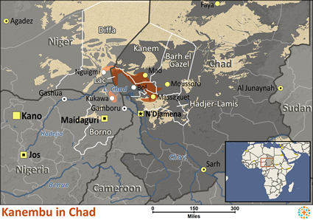
Pray for Nations “Declare His glory among the nations” Ps 96:3
Kanembu in Chad
Up until the 1200s, the Kanembu were the most powerful people group south of the Sahara Desert. Their empire rapidly declined during the 1500s. Today, rich natron deposits are scattered across more than 30,000 acres of Chad. They are found in salt mines, most of which the Kanembu people own. While most of the Kanembu are farmers, many earn a living by mining the natron. The Kanembu live in the desert region of northwestern Chad. Since the area
Presented by Joshua Project
Knowing Jesus More and Making Him Known
Weekly Bulletin
Sunday 7 April 2024
receives less than 12 inches of rain per year, farming is very difficult.
Ministry Obstacles
The people speak Kanembu, a Kanuri language that has various dialects. Those who are literate read and write Arabic, which is taught in their Islamic schools. Only portions of the Bible are available in their language.
Outreach Ideas
Believers can use Global Recordings Network (GRN) recordings in the Kanembu language to help them to understand what Jesus did for them.
Prayer Focus
Pray that the few Kanembu believers would allow the light of the Holy Spirit to shine through them in such a way that others will be drawn to their Savior. Ask God to raise up strong local churches that will plant other churches among the Kanembu. Ask the Holy Spirit to soften Kanembu hearts towards Christ. Ask that they would be receptive to His teachings, igniting a movement to Christ.
Population: | 256,000
World Population: | 1,000,300
Main Language: | Kanembu
Main Religion: | Islam
Bible: | Portions
Online Audio NT: | No
Jesus Film: | Yes
Audio Recordings: | Yes
Worship Service
10 am (with Live Stream)
Topic: Walk to Emmaus
Scripture: Luke 24:13-35
Preacher: Pastor Bijoy
VERSE FOR THE WEEK— Luke 24:13-19 13 Now that same day two of them were going to a village called Emmaus, about seven miles[a] from Jerusalem. 14 They were talking with each other about everything that had happened. 15 As they talked and discussed these things with each other, Jesus himself came up and walked along with them; 16 but they were kept from recognizing him.17 He asked them, “What are you discussing together as you walk along?” They stood still, their faces downcast. 18 One of them, named Cleopas, asked him, “Are you the only one visiting Jerusalem who does not know the things that have happened there in these days?” 19 “What things?” he asked. “About Jesus of Nazareth,” they replied. “He was a prophet, powerful in word and deed before God and all the people.
Pre-Service Prayer at 9:30 am in lounge, all welcome.
49 Maxwelton Drive, Mairangi Bay, North Shore, Auckland 0630
Ph 09 478-6314, Website: www.mairangichurch.org.nz, Email: office@mairangichurch.org.nz

Slide 2
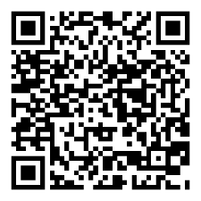
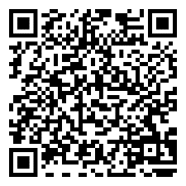
WELCOME TO MAIRANGI BAY COMMUNITY CHURCH (MBCC)
If this is your first time worshipping with us, please go to the Welcome Corner after the service. We will gladly answer your questions about our church. MBCC is an intentionally multi-cultural church and welcomes and celebrates all languages & cultures.
欢迎中国朋友参加. どの国の方も大歓迎します。
NEWS & EVENTS
PRAYER & INTERCESSION “and pray for one another,” James 5:16b Please visit the Prayer Wall in the foyer. Pin your prayers, answers to prayers and testimonies to the prayer wall. Remember to pray for the requests on our prayer wall.
GIVE THANKS & PRAY FOR
Pray for the church and brothers and sisters. May the Holy Spirit lead us to grow together in love and knowledge and bear the fruit of the Holy Spirit.
Pray for Ming, Kevin, Joyce and Shuping for their treatments. May God heal them and give them strength.
Church Outreach
Street Evangelism Sat 10.00 am – 12.00 pm Flora: 021 201 9577
Music For Kiddies (Japanese) School terms, every 2nd, 4th and 5th Thurs 10.30 am – 12.00 pm Maki: 027 3803627 (Japanese)
Food Bank Contact Caroline/Dalice
Good News Flower Arrangement Annie Zhang: 027 3939345
English Class：
Every Monday, 10-2 pm
Church downstairs
Grace (0226387288)
Encounter (Church Worship & Prayer Evening （every 1st and 3rd Sunday Evening)
7th April (Tonight), 21st April
You may pray in your own language with different language groups.
Other Monthly Worship Service in Different Languages (once a month)
Chinese Service:
Last Friday 7:30 pm (26th April)
If you would like to hear a Chinese translation, please ask for a headset. Please put the low battery headset in the yellow tray and the charged ones back to the original slot.
如果您需要听中文翻译可以向服事人员要一个耳机。请将需要充电的耳机放在黄色的盒子里，正常的耳机请放回原来的盒子。
CHURCH STAFF CONTACT INFORMATION
Church Office: 09 478 6314, office@mairangichurch.org.nz
General Office Hours: 9.30 am-12.30 pm, Tue - Fri (booking needed for appointments)
Acting Senior Pastor, David Yeh: 022 5220 670, david@mairangichurch.org.nz
Associate Pastor, Bijoy Joy: 020 4020 6404, bijoy@mairangichurch.org.nz
Chinese Evangelist, Wendy Liu: 021 0265 4800, wendy@mairangichurch.org.nz
Church Administrator, Cobi Wu: office@mairangichurch.org.nz
Passover Meal
22 April(Mon), 6.30pm @church,
$30 pp, RSVP, maximum 55 people.
Registration and payment
deadline is 14 April.
Ushers & Greeters & Tea Team
Training
14 April (next Sunday)
after the service @ Lounge.
Food Bank Contact
Caroline La Grange: 021 124 6996, carolinelagrange7@gmail.com
Dalice Yang: 022 065 1109, yangjie625@gmail.com
English Program
Every Sunday, 2pm-3:30pm
Start date: 14 April 2024
@church downstairs, please see
John & Vyviane for more details.
Want to give to God’s work through MBCC?
Contact the church office, or fill in this form and hand it in at the front desk
（please keep this as your own record as well!!)
I need an offering number (it is not necessary, but once you have had one, please use it as a reference consistently ) yes no
I need a donation receipt (for IRD tax rebate by the end of each financial year) Please show my name as (print):
and send to my email (print) :
General/Tithe donation 12-3050-0301948-00; Food Bank -03; Outreach -04
Newcomers Detail
please scan the QR code to fill in
Contact pastor David Yeh/Wendy for special/urgent prayer requests. Our Prayer Ministry Team will pray for you.
English
中文

