Slide 1
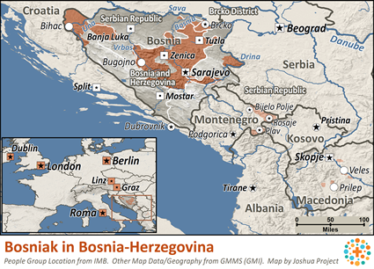
Pray for Nations “Declare His glory among the nations” Ps 96:3
Bosniak in Bosnia-Herzegovina
Bosniaks are typically characterized by their tie to the Bosnian historical region, traditional adherence to Islam and common culture and language. Once spread throughout the regions they inhabited, various instances of ethnic cleansing and genocide have had a tremendous effect on the territorial distribution of their population. Partially due to this, there is a notable Bosniak diaspora in a number of countries.
Presented by Joshua Project
Knowing Jesus More and Making Him Known
Weekly Bulletin
Sunday 24 March 2024
Ministry Obstacles:
The Bosniaks have experienced much harm over many years from those who have called themselves Christians. This isn't easy to overcome.
Outreach Ideas:
Christians need to build friendships with the Bosniaks, serving their physical and material needs.
Prayer Focus:
There are a few followers of Christ among the Bosniaks. Pray they would be bold in their witness for Christ, yet loving and tactful. Pray they would live holy lives, zealous to know and serve Jesus Christ. Pray the Bosniak people would understand that Jesus desires to bless their families and communities. Pray that the Bosniaks would hunger to find out more about Jesus (whom Muslims call Isa al-Masih), referred to in the Koran. Pray the Lord would open their eyes to his true nature and would draw many Bosniaks to himself.
Population: | 1,615,000
World Population: | 3,158,500
Main Language: | Bosnian
Main Religion: | Islam
Bible: | Complete
Online Audio NT: | No
Jesus Film: | Yes
Audio Recordings: | Yes
Worship Service
10 am (with Live Stream)
Topic: What is Communion？
Scripture: 1 Corinthians 11:23-33
Preacher: Pastor David
VERSE FOR THE WEEK— 1 Corinthians 11:23-33 23 For I received from the Lord what I also passed on to you: The Lord Jesus, on the night he was betrayed, took bread, 24 and when he had given thanks, he broke it and said, “This is my body, which is for you; do this in remembrance of me.” 25 In the same way, after supper he took the cup, saying, “This cup is the new covenant in my blood; do this, whenever you drink it, in remembrance of me.” 26 For whenever you eat this bread and drink this cup, you proclaim the Lord’s death until he comes.27 So then, whoever eats the bread or drinks the cup of the Lord in an unworthy manner will be guilty of sinning against the body and blood of the Lord. 28 Everyone ought to examine themselves before they eat of the bread and drink from the cup. 29 For those who eat and drink without discerning the body of Christ eat and drink judgment on themselves. 30 That is why many among you are weak and sick, and a number of you have fallen asleep. 31 But if we were more discerning with regard to ourselves, we would not come under such judgment. 32 Nevertheless, when we are judged in this way by the Lord, we are being disciplined so that we will not be finally condemned with the world.33 So then, my brothers and sisters, when you gather to eat, you should all eat together.
Pre-Service Prayer at 9:30 am in lounge, all welcome.
49 Maxwelton Drive, Mairangi Bay, North Shore, Auckland 0630
Ph 09 478-6314, Website: www.mairangichurch.org.nz, Email: office@mairangichurch.org.nz

Slide 2
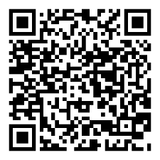
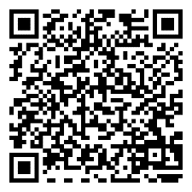
WELCOME TO MAIRANGI BAY COMMUNITY CHURCH (MBCC)
If this is your first time worshipping with us, please go to the Welcome Corner after the service. We will gladly answer your questions about our church. MBCC is an intentionally multi-cultural church and welcomes and celebrates all languages & cultures.
欢迎中国朋友参加. どの国の方も大歓迎します。
NEWS & EVENTS
PRAYER & INTERCESSION “and pray for one another,” James 5:16b Please visit the Prayer Wall in the foyer. Pin your prayers, answers to prayers or testimonies to the prayer wall. Remember to pray for the requests on our prayer wall.
GIVE THANKS & PRAY FOR
Pray for the church and brothers and sisters, may the Holy Spirit lead us to grow together in love and knowledge, take root in the Rock of Christ downward, and bear the fruit of the Holy Spirit.
Pray for Ming, Kevin, Joyce and Shuping for their therapies. May God heal them and give them strength.
Church Outreach
Street Evangelism Sat 10.00 am – 12.00 pm Flora: 021 201 9577
Music For Kiddies (Japanese) School terms, every 2nd, 4th and 5th Thurs 10.30 am – 12.00 pm Maki: 027 3803627 (Japanese)
Food Bank Contact Caroline/Dalice
Good News Flower Arrangement Annie Zhang: 027 3939345
English Class：
Every Monday 10-2 pm church
downstairs
Grace (0226387288)
Encounter (Church Worship & Prayer Evening （every 1st and 3rd Sunday Evening)
7th April, 21st April
You may pray in your mother tongue with different language groups.
Other Monthly Worship Service in Different Languages (once a month)
Chinese Service:
Last Friday each month 7:30pm
If you would like to hear a Chinese translation, please ask for a headset. Please put the low battery headset at the yellow tray and the charged ones back to the original slot.
如果您需要听中文翻译可以向服事人员要一个耳机。请将需要充电的耳机放在黄色的盒子里，正常的耳机请放回原来的盒子。
CHURCH STAFF CONTACT INFORMATION
Church Office: 09 478 6314, office@mairangichurch.org.nz
General Office Hours: 9.30 am-12.30 pm, Tue - Fri (booking needed for appointments)
Acting Senior Pastor, David Yeh: 022 5220 670, david@mairangichurch.org.nz
Associate Pastor, Bijoy Joy: 020 4020 6404, bijoy@mairangichurch.org.nz
Chinese Evangelist, Wendy Liu: 021 0265 4800, wendy@mairangichurch.org.nz
Church Administrator, Cobi Wu: office@mairangichurch.org.nz
Shared Lunch
31st Mar(Easter Sunday),
after the service,
Please bring a dish to share
Ushers & Greeters & Tea Team
Training postpone to 14 April after the service @ lounge
Food Bank Contact
Caroline La Grange: 021 124 6996, carolinelagrange7@gmail.com
Dalice Yang: 022 065 1109, yangjie625@gmail.com
Healing Tramua Series
Starting from 27 Mar, 12 weeks,
Every Wednesday 10 -1pm,
@ church lounge
Want to give to God’s work through MBCC?
Contact the church office, or fill in this form and hand it in at the front desk
（please keep this as your own record as well!!)
Please I need an offering number (it is not necessary, but once you have had one, please use it as a reference consistently ) yes no
I need the donation receipt (for IRD tax rebate by the end of each financial year) please show my name as (print):
and send through my email (print) :
General/Tithe donation 12-3050-0301948-00; Food Bank -03; Outreach -04
Passover Meal
22 April(Mon), 6.30pm @church
$30 pp, RSVP, maximum 55 people.
Registration deadline is 14 April
Newcomers Detail
please scan the QR code to fill in
Contact pastor David Yeh/Wendy for the special/urgent prayer requests. Our Prayer Ministry Team will pray for you upon your requests.
English
中文

