Slide 1

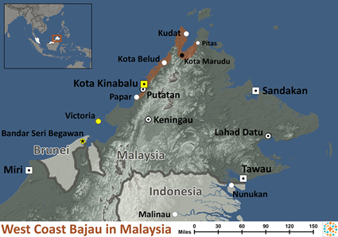
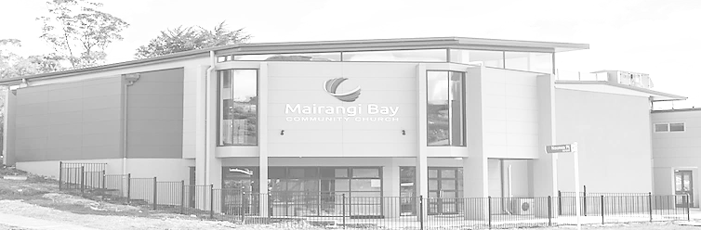
Pray for Nations “Declare His glory among the nations” Ps 96:3
West Coast Bajau in Malaysia
The West Coast Bajau of Sabah, Malaysia have traditionally been known as sea nomads, dwelling in boats and engaging in maritime trading. While some Bajau continue to derive their livelihood primarily from the sea, others have adopted an agrarian way of life.
Ministry Obstacles: The Bajau are staunchly faithful to Islam. They
Presented by Joshua Project
Knowing Jesus More and Making Him Known
Weekly Bulletin
Sunday 28 January 2024
believe that to be Bajau is to be Muslim.
Outreach Ideas: Scriptures and Christian resources are not available in their language. A Bajau radio station broadcasts daily, and Christian radio broadcasts could prove effective in reaching them.
Scripture Focus: "And I will make of you a great nation, and I will bless you and make your name great, so that you will be a blessing. I will bless those who bless you, and him who dishonors you I will curse, and in you all the families of the earth shall be blessed." Genesis 12:2-3
Prayer Focus: Pray that followers of Christ in surrounding communities would share the gospel with the Bajau. Pray that the love of Jesus Christ would touch these masters of the sea in such a way that there would be a spontaneous church planting movement.
Population: | 258,000
World Population: | 269,000
Main Language: | Bajau, West Coast
Main Religion: | Islam
Bible: | Translation Needed
Online Audio NT: | No
Jesus Film: | No
Audio Recordings: | No
Status | Unreached
Worship Service
10 am (with Live Stream)
Topic: Drawing Closer to God (1)
Scripture: 2 Timothy 3:16-17
Preacher: Pastor David
VERSE FOR THE WEEK—
2 Timothy 3:16-17: All Scripture is God-breathed and is useful for teaching, rebuking, correcting and training in righteousness, 17 so that the servant of God may be thoroughly equipped for every good work.
1 Thessalonians 5:16-18: Rejoice always, 17 pray continually, 18 give thanks in all circumstances; for this is God’s will for you in Christ Jesus.
Proverbs 21:5: The plans of the diligent lead to profit as surely as haste leads to poverty.
Ephesians 5:15-16: Be very careful, then, how you live—not as unwise but as wise, 16 making the most of every opportunity, because the days are evil.
Pre-Service Prayer at 9:30 am in lounge, all welcome.
49 Maxwelton Drive, Mairangi Bay, North Shore, Auckland 0630
Ph 09 478-6314, Website: www.mairangichurch.org.nz, Email: office@mairangichurch.org.nz

Slide 2

WELCOME TO MAIRANGI BAY COMMUNITY CHURCH (MBCC)
If this is your first time worshipping with us, please go to the Welcome Corner after the service. We will gladly answer your questions about our church. MBCC is an intentionally multi-cultural church and welcomes and celebrates all languages & cultures.
欢迎中国朋友参加. どの国の方も大歓迎します。
NEWS & EVENTS
PRAYER & INTERCESSION
“and pray for one another,” James 5:16b
Please visit the Prayer Wall in the foyer. Pin your prayers, answers to prayers or testimonies to the prayer wall. Remember to pray for the requests on our prayer wall.
GIVE THANKS & PRAY FOR
Pray for the church and brothers and sisters, may the Holy Spirit lead us to grow together in love and knowledge, take root in the Rock of Christ downward, and bear the fruit of the Holy Spirit.
Pray for Ming, Kevin, Joyce and Shuping for their therapies. May God heal them and give them strength.
Please pray for all brothers and sisters who are on vacation overseas. May the Lord keep their journey safe and take care of their health.
Church Outreach
Street Evangelism
Sat 10.00 am – 12.00 pm
Flora: 021 201 9577
Music For Kiddies (Japanese)
School terms, every 2nd, 4th and 5th Thurs 10.30 am – 12.00 pm
Maki: 027 3803627 (Japanese)
Food Bank Contact Caroline/Dalice
Good News Flower Arrangement
Annie Zhang: 027 3939345
English Class：
Every Monday 10-2 pm church
downstairs
Grace (0226387288)
Encounter (Church Worship & Prayer Evening （every 1st and 3rd Sunday Evening)
Will resume on February 2024
You may pray in your mother tongue with different language groups.
Other Monthly Worship Service in Different Languages (once a month)
Chinese Service:
Last Friday each month 7:30pm
If you would like to hear a Chinese translation, please ask for a headset. Please put the low battery headset at the yellow tray and the charged ones back to the original slot.
如果您需要听中文翻译可以向服事人员要一个耳机。请将需要充电的耳机放在黄色的盒子里，正常的耳机请放回原来的盒子。
CHURCH STAFF CONTACT INFORMATION
Church Office: 09 478 6314, office@mairangichurch.org.nz
General Office Hours: 9.30 am-12.30 pm, Tue - Fri (booking needed for appointments)
Acting Senior Pastor, David Yeh: 022 5220 670, david@mairangichurch.org.nz
Associate Pastor, Bijoy Joy: 020 4020 6404, bijoy@mairangichurch.org.nz
Chinese Evangelist, Wendy Liu: 021 0265 4800, wendy@mairangichurch.org.nz
Church Administrator, Cobi Wu: office@mairangichurch.org.nz
Baptism
25th February
Register with Wendy or church office,
Registration deadline:18th Feb
Church Picnic Day
11th February after service,
@Long Bay Regional Park, please prepare your own lunch. It will be postponed if rains.
Food Bank Contact
Caroline La Grange: 021 124 6996, carolinelagrange7@gmail.com
Dalice Yang: 022 065 1109, yangjie625@gmail.com
Chinese Alpha Course
start on Sunday 3 March 2024.
Please contact Frieda or Wendy
021-0265 4800
Want to give to God’s work through MBCC?
Contact the church office, or fill in this form and hand it in at the front desk
（please keep this as your own record as well!!)
Please I need an offering number (it is not necessary, but once you have had one, please use it as a reference consistently ) yes no
I need the donation receipt (for IRD tax rebate by the end of each financial year)
please show my name as (print):
and send through my email (print) :
General/Tithe donation 12-3050-0301948-00; Food Bank -03; Outreach -04
Healing Trauma teaching series
From 31 January (8weeks)，each Wednesdays 10am to 1pm & 6:30pm to 9:30pm @church，Free
Contact pastor David Yeh/Wendy for the special/urgent prayer requests. Our Prayer Ministry Team will pray for you upon your requests.
All Life Group &
Sunday School & Youth will
back to normal in Feb

