Slide 1

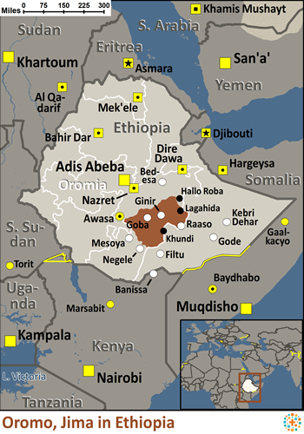
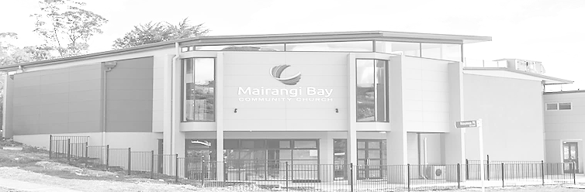
Pray for Nations “Declare His glory among the nations” Ps 96:3
Jima Oromo in Ethiopia
The various Oromo people groups are the largest, most widely dispersed groups in Ethiopia. Composed of approximately a dozen tribal clusters including the Jima, these peoples prefer just the term "Oromo" when speaking of themselves. One basic value of the Oromo is tokuma, meaning group identity. The religious, social, political and economic life of the Oromo revolves around this. Most Oromo groups are Muslim, but there are some Christians among certain subgroups.
Ministry Obstacles: The Oromo are strongly tied to a group identity. Due to this "tokuma", missionaries can find it hard to convince them to give Christ a chance, as most of them are not willing to run the risk of being ostracized.
Outreach Ideas: Missionaries with electrical engineering backgrounds can build water electricity generators, etc. Doctors and those with science backgrounds can assist in water purification projects and help with medical needs. Veterinarians can help with their livestock.
Scripture Focus: "Praise the LORD, all nations! Extol him, all peoples!" Psalm 117:1
Prayer Focus: Pray that Jima Oromo believers would have strength in the Holy Spirit to stay firm in their faith. Pray the Oromo tribes of Ethiopia would be able to provide improved education for their children, and for a rising standard of living. Pray for a movement to Christ among the Jima Oromo people.
Presented by Joshua Project
Knowing Jesus More and Making Him Known
Weekly Bulletin
Sunday 26 May 2024
Population: | 4,112,000
World Population: | 4,112,000
Main Language: | Oromo
Main Religion: | Islam
Bible: | New Testament
Online Audio NT: | Yes
Jesus Film: | Yes
Audio Recordings: | Yes
Worship Service
10 am (with Live Stream)
Topic: How to build Friendship
with the Holy Spirit
Scripture: 1 Corinthians 2:10-14
Preacher: Pastor David
VERSE FOR THE WEEK— 1 Corinthians 2:10-14
10 these are the things God has revealed to us by his Spirit. The Spirit searches all things, even the deep things of God. 11 For who knows a person’s thoughts except their own spirit within them? In the same way no one knows the thoughts of God except the Spirit of God. 12 What we have received is not the spirit of the world, but the Spirit who is from God, so that we may understand what God has freely given us. 13 This is what we speak, not in words taught us by human wisdom but in words taught by the Spirit, explaining spiritual realities with Spirit-taught words.[a] 14 The person without the Spirit does not accept the things that come from the Spirit of God but considers them foolishness, and cannot understand them because they are discerned only through the Spirit.
Pre-Service Prayer at 9:30 am in lounge, all welcome.
49 Maxwelton Drive, Mairangi Bay, North Shore, Auckland 0630
Ph 09 478-6314, Website: www.mairangichurch.org.nz, Email: office@mairangichurch.org.nz

Slide 2

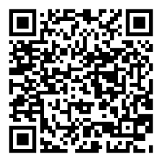
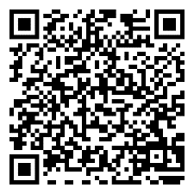
WELCOME TO MAIRANGI BAY COMMUNITY CHURCH (MBCC)
If this is your first time worshipping with us, please go to the Welcome Corner after the service. We will gladly answer your questions about our church. MBCC is an intentionally multi-cultural church and welcomes and celebrates all languages & cultures.
欢迎中国朋友参加. どの国の方も大歓迎します。
NEWS & EVENTS
PRAYER & INTERCESSION
“and pray for one another,” James 5:16b
Please visit the Prayer Wall in the foyer. Pin your prayers, answers to prayers and testimonies. Remember to pray for the requests.
GIVE THANKS & PRAY FOR
Pray for the church and brothers and sisters. May the Holy Spirit lead us to grow together in love and knowledge and bear the fruit of the Holy Spirit.
Pray for Ming, Kevin, Joyce and Shuping for their treatments. May God heal them and give them strength.
Church Outreach
Street Evangelism
Sat 10.00 am – 12.00 pm
Flora: 021 201 9577
Music For Kiddies (Japanese)
School terms, every 2nd, 4th and 5th Thurs 10.30 am – 12.00 pm
Maki: 027 3803627 (Japanese)
Food Bank Contact Caroline/Dalice
Good News Flower Arrangement
Annie Zhang: 027 3939345
English Class：
Every Monday, 10-2 pm
Church downstairs
Grace (0226387288)
Encounter (Church Worship & Prayer Evening （every 1st and 3rd Sunday Evening)
2nd June 16th June
You may pray in your own language with different language groups.
Other Monthly Worship Service in Different Languages (once a month)
Chinese Service:
Last Friday of each month, 7:30 pm
If you would like to hear a Chinese translation, please ask for a headset. Please put the low battery headset in the yellow tray and the charged ones back to the original slot.
如果您需要听中文翻译可以向服事人员要一个耳机。请将需要充电的耳机放在黄色的盒子里，正常的耳机请放回原来的盒子。
CHURCH STAFF CONTACT INFORMATION
Church Office: 09 478 6314, office@mairangichurch.org.nz
General Office Hours: 9.30 am-12.30 pm, Tue - Fri (booking needed for appointments)
Acting Senior Pastor, David Yeh: 022 5220 670, david@mairangichurch.org.nz
Associate Pastor, Bijoy Joy: 020 4020 6404, bijoy@mairangichurch.org.nz
Chinese Evangelist, Wendy Liu: 021 0265 4800, wendy@mairangichurch.org.nz
Church Administrator Joanne Sham: office@mairangichurch.org.nz
Wheat Sale
$40 per container,
Today,
after service @ downstairs，
see John Tan for more details.
Quiz Night
Time: 5pm-7:30pm 20th July,
@church downstairs.
Sign up in groups of 5, everyone is invited, any age and any language.
Food Bank Contact
Caroline La Grange: 021 124 6996, carolinelagrange7@gmail.com
Dalice Yang: 022 065 1109, yangjie625@gmail.com
Bible League
The Philip Project
13th July
9.30 - 4.30 pm @ church
Please register at the back of the auditorium.
Contact pastor David Yeh/Wendy for special/urgent prayer requests. Our Prayer Ministry Team will pray for you.
Want to give to God’s work through MBCC?
Contact the church office, or fill in this form and hand it in at the front desk.
I need an offering number (it is not necessary, but once you have had one, please use it as a reference consistently ) yes no
I need a donation receipt (for IRD tax rebate by the end of each financial year)
Please show my name as (print):
and send to my email (print) :
General/Tithe donation 12-3050-0301948-00; Food Bank -03; Outreach -04
Newcomers Detail
please scan the QR code to fill in
English
中文

