Slide 1

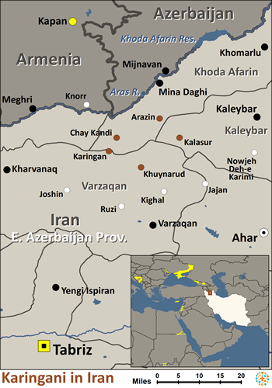
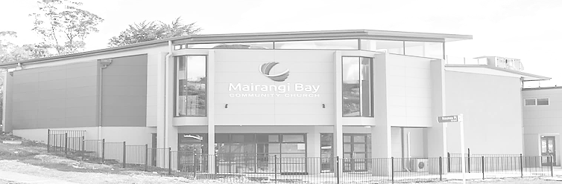
Pray for Nations “Declare His glory among the nations” Ps 96:3
Karingani in Iran
The Karingani are a minority language group in Iran, who are Muslim. They live near the Azerbaijani border and south of the Caspian Sea in stone or adobe housing. That is beginning to change due to the impact of urban culture. They primarily farm rice, wheat and barley while others weave rugs and make felt. The Karingani practice Shia Islam mixed with animistic beliefs in spirits and sacred groves, used for spirit worship. They fear the Red Woman, who is responsible for infant and maternal mortality. Thus, their form of Islam is blended with ancient beliefs. There are no known Christ followers among them.
Ministry Obstacles: There is no Bible in their primary language. Current Islamic politics close them off from a traditional missionary presence.
Outreach Ideas: Christian anthropologists and linguists could live and work among them to study their lives and language. With knowledge of the language, these Christian believers can later produce radio and television materials.
Prayer Focus: Pray the Holy Spirit would prepare them for a Christ encounter. Pray they would become disillusioned with the current Islamic regime and begin to seek and find the true holiness personified by Jesus Christ. Pray for Christian linguists and anthropologists to live and work among them to do Bible translation and witness. Pray for a people movement among them that will extend to others.
Presented by Joshua Project
Knowing Jesus More and Making Him Known
Weekly Bulletin
Sunday 10 September 2023
10/40 Window: | Yes
Population: | 24,000
World Population: | 24,000
Main Language: | Karingani
Main Religion: | Islam
Bible: | Unspecified
Online Audio NT: | No
Jesus Film: | No
Audio Recordings: | No
Christian Adherent: | 0%
Worship Service
10 am (with Live Stream)
Topic: Church as School
Scripture: Acts 2:42-47
Preacher: Bijoy Joy
VERSE FOR THE WEEK – Acts 2:42-47
They devoted themselves to the apostles' teaching and to fellowship, to the breaking of bread and to prayer. Everyone was filled with awe at the many wonders and signs performed by the apostles. All the believers were together and had everything in common. They sold property and possessions to give to anyone who had need. Every day, they continued to meet together in the temple courts. They broke bread in their homes and ate together with glad and sincere hearts, praising God and enjoying the favor of all the people. And the Lord added to their number daily those who were being saved
Pre-Service Prayer at 9:30 am in lounge, all welcome.
49 Maxwelton Drive, Mairangi Bay, North Shore, Auckland 0630
Ph 09 478-6314, Website: www.mairangichurch.org.nz, Email: office@mairangichurch.org.nz

Slide 2

WELCOME TO MAIRANGI BAY COMMUNITY CHURCH (MBCC)
If this is your first time worshipping with us, please go to the Welcome Corner after the service. We will gladly answer your questions about our church. MBCC is an intentionally multi-cultural church and welcomes and celebrates all languages & cultures.
欢迎中国朋友参加. どの国の方も大歓迎します。
NEWS & EVENTS
PRAYER & INTERCESSION
“and pray for one another,” James 5:16b
Please visit the Prayer Wall in the foyer. Pin your prayers, answers to prayers or testimonies to the prayer wall. Remember to pray for the requests on our prayer wall.
GIVE THANKS & PRAY FOR
Pray for the Chinese Alpha Course which started on July 23rd. May the Holy Spirit lead us to grow together in love and knowledge, take root in the Rock of Christ downward, and bear the fruit of the Holy Spirit.
Pray for Pastor David, Pray that the Almighty Lord heal him and restore his lung from shortness of breath symptoms.
Church Outreach
Street Evangelism
Sat 10.00 am – 12.00 pm
Flora: 021 201 9577
Music For Kiddies (Japanese)
School terms, every 2nd, 4th and 5th Thurs 10.30 am – 12.00 pm
Maki: 027 3803627 (Japanese)
Food Bank Contact Caroline/Dalice
Good News Flower Arrangement
Annie Zhang: 027 3939345
Alpha:
every Sunday 11:45-1.30 (Chinese)
English Class：
Every Monday 10-2 pm church
downstairs
Grace (0226387288)
Encounter (Church Worship & Prayer Evening （every 1st and 3rd Sunday Evening)
10th September (Tonight ) 17th September
You may pray in your mother tongue with different language groups.
Other Monthly Worship Service in Different Languages (once a month)
Chinese Service:
Last Friday 7:30pm (29th September)
Young Adult Service:
Last Sunday 5.30 pm (24th September)
If you would like to hear a Chinese translation, please ask for a headset. Please put the low battery headset at the yellow tray and the charged ones back to the original slot.
如果您需要听中文翻译可以向服事人员要一个耳机。请将需要充电的耳机放在黄色的盒子里，正常的耳机请放回原来的盒子。
CHURCH STAFF CONTACT INFORMATION
Church Office: 09 478 6314, office@mairangichurch.org.nz
General Office Hours: 9.30 am-12.30 pm, Tue - Fri (booking needed for appointments)
Acting Senior Pastor, David Yeh: 022 5220 670, david@mairangichurch.org.nz
Associate Pastor, Bijoy Joy: 020 4020 6404, bijoy@mairangichurch.org.nz
Chinese Evangelist, Wendy Liu: 021 0265 4800, wendy@mairangichurch.org.nz
Church Administrator, Cobi Wu: office@mairangichurch.org.nz
Life Group Leaders Meeting:
next Sunday(17th September)
after service
@lounge
Healing Trauma Ministry
A healing and Prayer Workshop,
From 6 September,5 weeks,
each Wednesdays:
6:30-9pm @MBCC
Food Bank Contact
Caroline La Grange: 021 124 6996, carolinelagrange7@gmail.com
Dalice Yang: 022 065 1109, yangjie625@gmail.com
Paint Party
A break from busy life,
all supplements provided,
16 September(Next Saturday)
10-1pm @ MBCC, free
Want to give to God’s work through MBCC?
Contact the church office, or fill in this form and hand it in at the front desk
（please keep this as your own record as well!!)
Please I need an offering number (it is not necessary, but once you have had one, please use it as a reference consistently ) yes no
I need the donation receipt (for IRD tax rebate by the end of each financial year)
please show my name as (print):
and send through my email (print) :
General/Tithe donation 12-3050-0301948-00; Food Bank -03; Outreach -04
Contact pastor David Yeh/Wendy for the special/urgent prayer requests. Our Prayer Ministry Team will pray for you upon your requests.

